Slide 1
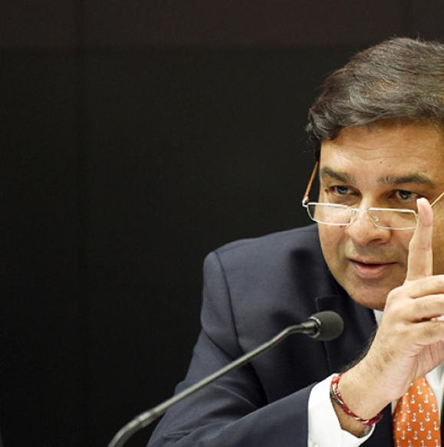

Monetary Policy: Tools
Volume of credit
Quantitative/Gen./Indirect
Qualitative: Selective, Direct
Reserve Ratios (CRR, SLR)
OMO & MSS
Rates: Bank, MSF, LAF [Repo, RR]
Selective Credit Control (SCC), PSL: Credit Rationing, Subsidy [fiscal policy]
Moral Suasion
Direct Action
+review of last one year’s policies
Consumer Credit control / EMI
Margin / LTV
Distribution of credit
But in the first Monetary policy of FY18, so many new updates..

Slide 2

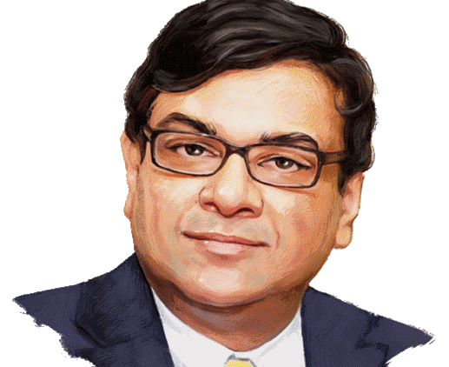
2017, April: first Bi-Monthly Monetary Policy?
Deflation, Demand Boost
Inflation
Repo Rate (Policy Rate)

Slide 3

Repo Hike ▲ or Repo HOLD = or Repo CUT ▼
1st MP of FY18
Since Oct-2016: crude oil price ▲ 10% due to OPEC Cuts ☹
Post demonetization, vegetable prices ▼ due to distress sale, but now ▲ after re-monetization ☹
7TH PC: House rent allowance ▲, state govt also to offer similar. Likelihood that rents will ▲ ☹
Notes:
Domestic petrol-diesel prices, ▲ by ~5 per litre.

Slide 4
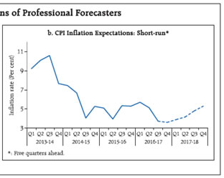

2017, April: first Bi-Monthly Monetary Policy?
Deflation, Demand Boost
Inflation
Inflation projection: likely to increase but wait and watch till IMD Monsoon forecast comes
Repo Rate (Policy Rate)

Slide 5
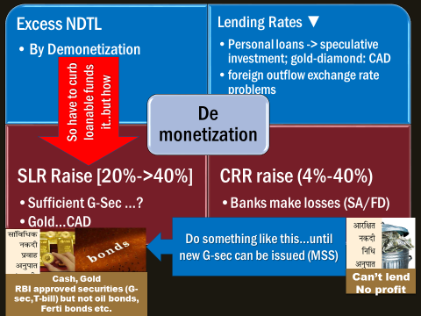
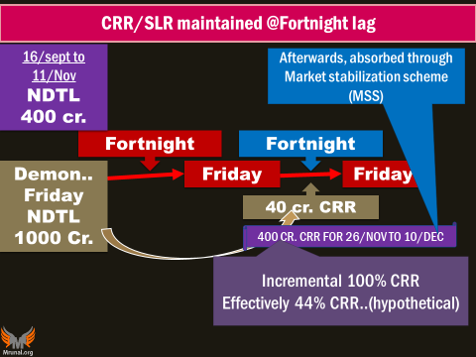
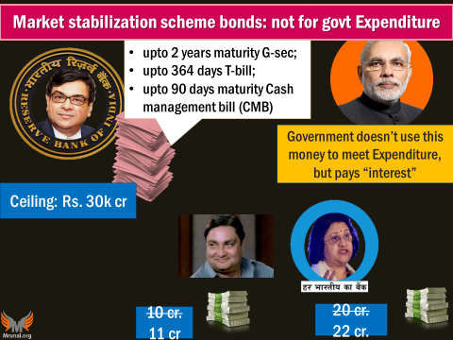
But now those CMB bills are maturing ☹
Again excess liquidity…?

Slide 6

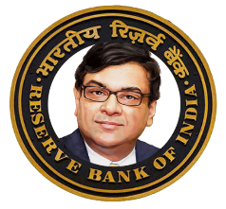


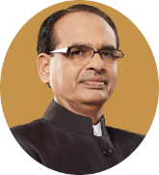


LAF Reverse Repo Rate: you’ve to increase…to attract bankers
Reverse Repo Rate 5.75%
100 crore
RBI to Repurchase
@105.75 Cr.
After 1|7|14 days
“it is interest rate paid by RBI to its clients for short term loans.” all clients eligible. RR = R% -1% nahi 0.5%

Slide 7
Policy corridor:1%-> 0.5% (Apr. 2016)-> 0.25%(Apr.2017)
Reverse Repo (2000)
MSF (2011)
+0.50%
Repo (2000)
6.25%
-0.50%
Align with call rate
..that too and absorb MSS matured liquidity
Liquidity Adjustment Facility (LAF) window
+0.25%
-0.25%
You’ve decided to “HOLD” repo, fearing inflation
How can you raise reverse repo to attract bankers?

Slide 8
Mock
Find Correct Statement(s)
Government bears the interest on MSS bonds
RBI bears the interest on Reverse Repo rate
Both A and B
Neither A nor B

Slide 9

RBI’s Window operations require G-Sec- buying, selling, collateral
OMO
G-Sec
T-Bills-upto 364 days
MSS’04
G-sec (upto 2 years)
T-bill-upto 364 days
LAF’2000
Repo-SLR securities
MSF’2011
Repo: inject Liquidity
RR: Suck liquidity
CMB’90 days
Sell: Suck liquidity
Inject liquidity
Buy: Inject liquidity
Sell: Suck liquidity
Fight Deflation
Inject Liquidity
Fight Inflation
Suck liquidity

Slide 10
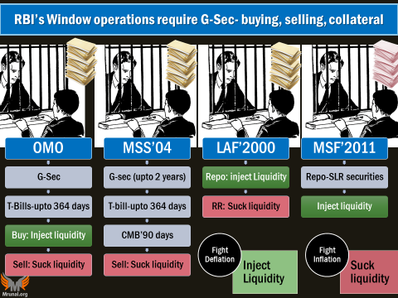
SDF
Inject Liquidity
Absorb Liquidity
Without collateral
Without Limit (MSS- 6L cr.)
Standing Deposit Facility (SDF)
Urjit Patel Committee had proposed.
Now RBI to “explore”

Slide 11


Liquidity adjustment facility (LAF): Repo Rate: WEF 2000,
Repo Rate 6.25%
100 crore
client to Repurchase
@106.25 Cr.
Overnight (1 day),
7 days, 14 days
Collateral: G-Sec
But not from SLR
MP1-FY18: Repo collaterals can be substituted.
"Interest Event“, "Tax Event", "Liquidity"
All clients eligible

Slide 12




Parties to a “Tri-Party” Repo-agreement (RBI will explore)
Custodian
Lender
Borrower
Corporate
Develop, Deepening of Corporate Bond market. (AIFI, LIC, GIC?)
Borrowing without disclosing identity, collateral, credit rating.
HR Khan Committee. US-EU already have it since 80s-90s

Slide 13


Digital Payment systems: classification of
Digital Payment System
Real time
Immediate Payment Service (IMPS)
Delayed Settlement
National Electronic Clearing Service (NECS)
Cards system (Visa, MasterCard and RuPay).
National Electronic Fund Transfer (NEFT)
National Automated Clearing House (NACH)
Real Time Gross settlement (RTGS)

Slide 14
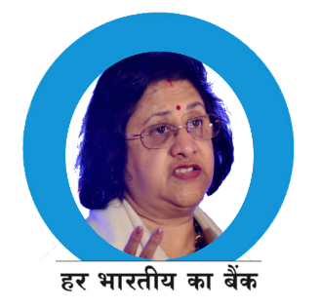
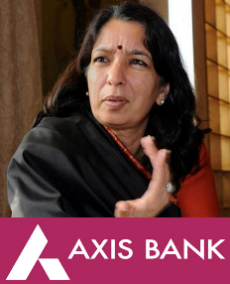


NEFT: Hourly settlement but only in weekday (8AM-7PM)
A settlement system where a large number of transactions are accumulated and offset against each other, with only the net difference being transferred at the end of a given settlement cycle.
Sending | SBI | Axis
customer#1 | 5 | 5
customer#2 | 5 | 3
Total (8AM-9AM) | 10 | 8
NET (incoming) | -2 | 2

Slide 15

MP1-FY18: NEFT settlement: before “hourly”, now “half-hourly”
If settlement every 30 minutes, how many settlements will be there from 8AM to 7PM?
21
22
23
24
Under Vision-2018 for digital payment

Slide 16
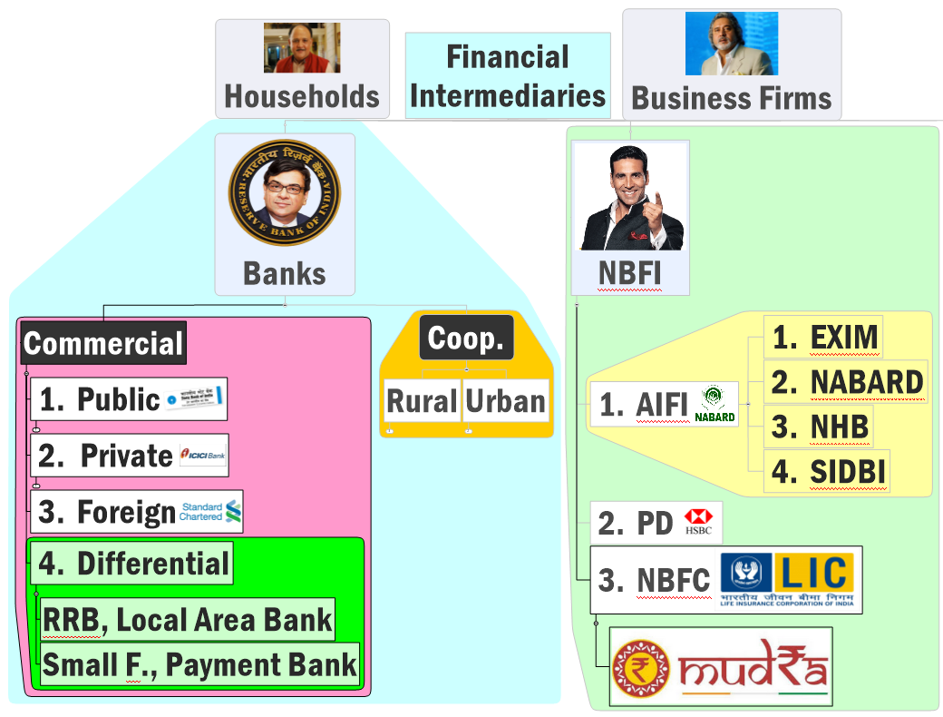


Banks: NDTL
NBFC: NOF
“net owned Funds”*

Slide 17



*NOF: Net owned funds: liability, capital etc (not IMP)
Net owned funds
Mutual funds
Venture Capital funds (VCF)
ReITs
InVITs
MP1-FY18 upto 10% permitted.
What are these? We’ll see with “Finance” lecture.

Slide 18
2017, April: first Bi-Monthly Monetary Policy?
Repo collaterals substituted
Policy corridor 50-> 25 basis points.
NEFT window: 1hr-> 30 minutes.
Banks NOF in REITS and INVITS.
No need for CCCB as of now.
Will explore: Tri-Party Repo, Wholesale Banks [in classification lecture]
New guidelines for PPIs
No change in MDR until final guidelines.
Centres for Financial Literacy (CFL) with help of NGO, @Block level.

